Slide 1
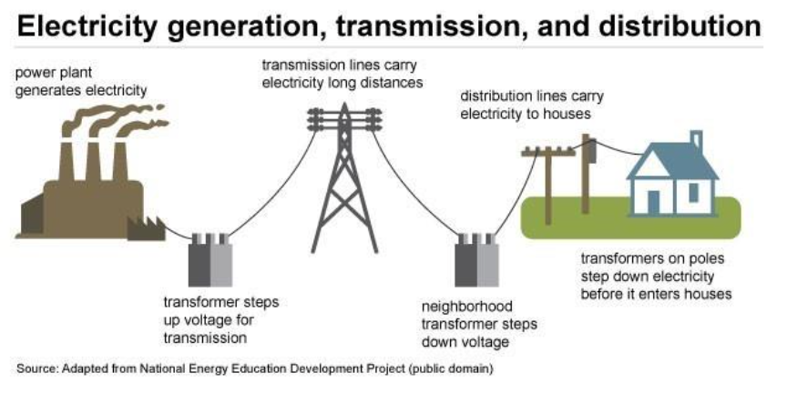
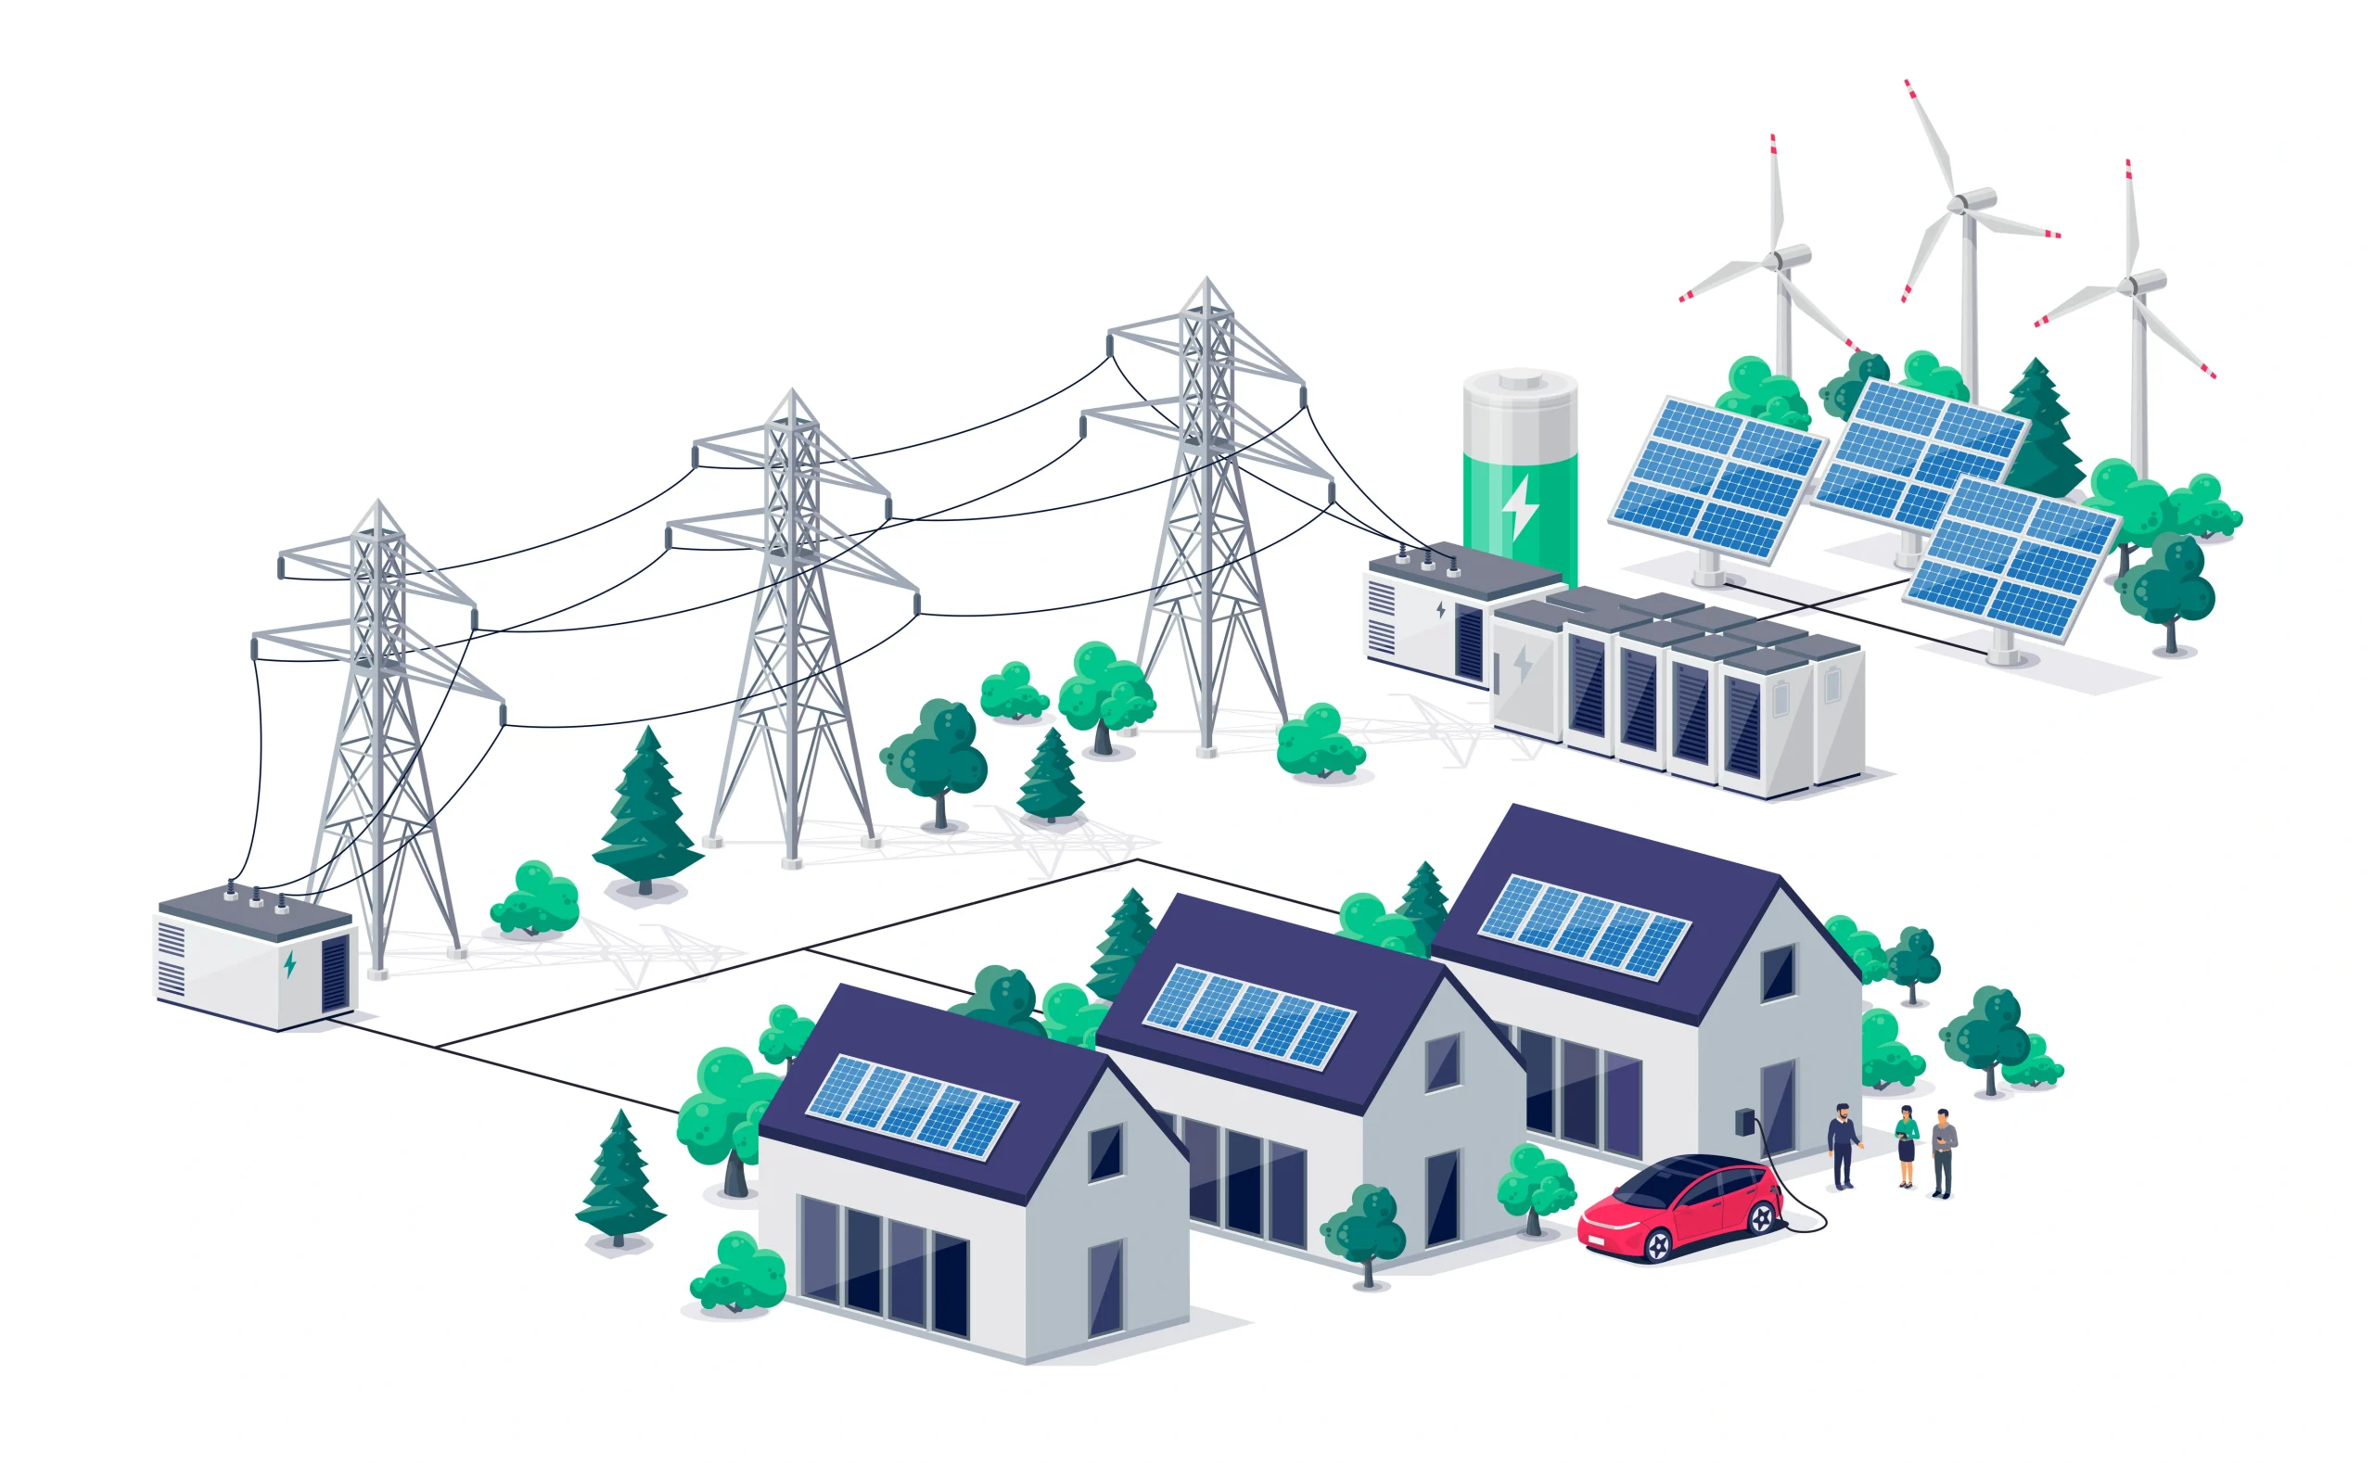

What are Virtual Power Plants (VPP)?
and What do VPP Do?
What we have been dreaming of for 25 years
What we have now
VPP 101 – The Basics
The Definitions of “VPP things”
Where VPP came from
What changed to advance VPP
Next Steps for New Jersey VPP
Michael Winka
New Jersey –NJ-ECN
March 19, 2026

Slide 2
VPP Terms and Definitions
Energy Efficiency EE - Equipment or Appliance that perform the same work with lower energy use
Demand Response DR - Demand response (DR) is a program where electricity consumers—households or businesses—are incentivized
or paid to voluntarily reduce or shift their energy usage during peak times or when the power grid is under stress.
Demand Flexibility DF - is the ability of energy users to intelligently shift or reduce electricity consumption in response to grid conditions,
market signals, or renewable energy availability. Requires smart appliance like smart thermostats.
Grid Interactive Efficient Buildings GEB - are energy-efficient structures that use smart technology, sensors, and on-site energy
resources (like solar or batteries) to interact with the electric grid.
Electric Vehicles EV - is a vehicle powered exclusively by one or more electric motors, using energy stored in rechargeable battery packs
rather than burning gasoline or diesel and can include the EV charger system.
Behind the Meter (BTM) Solar and Storage (S & S) - is an on-site power generation or storage system installed on a customer's side of the utility meter,
such as rooftop solar or a home battery,
Distributed Energy Resources DER - are small-scale, decentralized resources located close to the point of consumption that are BTM and/or connected
to the distribution system including solar, batteries, EV, microturbines/combined heat and power, DR, DF, GEB, and EE.
Virtually Power Plants VPP – is a cloud-based distributed network aggregation of DER hat can provide grid services
Smart Grid SG - is a network that uses digital technology, two-way communication, and automated control systems to manage electricity flow efficiently.
It enables real-time monitoring of energy consumption, integration of DER and increased reliability by automatically responding to disruptions and balancing demand.
DER Aggregators DERA – are entities that aggregate and coordinate DER customers to allow to participate in the energy market for grid services
FERC Order 2222 – is the Order that requires RTO to update their tariffs to allow DERs to participate in the energy market through aggregation
ZigBee - is a wireless technology standard designed for low-cost, low-power, and short-range communication in Internet of Things (IoT) and machine-to-machine (M2M) networks.
Distributed Energy Resource Monitoring Systems DERMS - is a software platform used by grid operators to manage, monitor, and control DER
that enables utilities to aggregate, optimize, and forecast these assets to increase grid reliability, efficiency, and flexibility.
Grid Modernization Grid Mod - is the process of upgrading the electric grid’s physical infrastructure and digital technologies to create a more resilient, reliable,
secure, and flexible energy system that involves integrating smart grid technology and DER to improve efficiency, reduce emissions, and manage, distribute, and consume electricity more effectively
Integrated Distribution Planning IDP - is a comprehensive, proactive, and stakeholder-driven process for developing long-term strategies for electricity grids.
It aligns utility investments with policy goals, grid modernization, and the increasing integration of DERs ensuring safe, reliable, and cost-effective distribution.

Slide 3
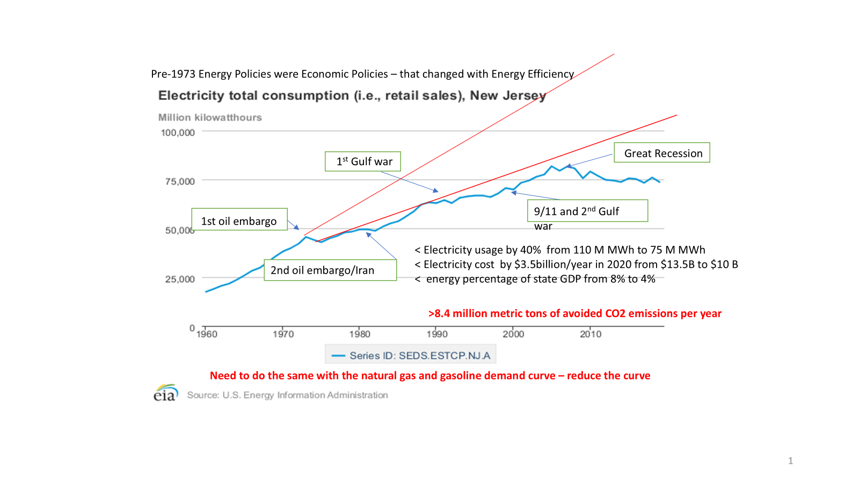
Where we Came from with DR -
There have always been Utility DR programs
Utilities had radio control programs for Central AC
2008 BPU Order for Utility DR programs
PJM has had DR programs
Curtailment Service Provider (CSP)
Emergency DR – Capacity shortage
Economic DR – When prices are high
Capacity Performance
Distributed Resource Management Systems DRMS
one-way communication limited to not smart thermostats
Up until now electricity usage and peak were relatively flat
Peak usage drives cost

Slide 4
What has Changed or is Changing to allow VVP
Smart Meters/Smart Grid – Response to Irene & Sandy
Microgrids/CHP – Response to Irene & Sandy
Microgrid is a number of interconnected loads powered by small scale on-site resources (DER) that are connected to the distribution system
at a point of common coupling that can operate in parallel with the grid and isolate (islanded) from the grid.
Typically included combined heat and power (CHP) that generates both thermal and electric energy for onsite use or export to the grid.
Zig-Bee - led to Interoperability Standards – IEEE and UL
Smart Inverters – Can now provide ride through, frequency, voltage,
VAR, and other ancillary services (grid following to grid forming)
Lower Cost solar, batteries and EV/EV charging
DERMS - Distribute Energy Resource Monitoring Systems
Demand is up and so is the peak

Slide 5
Where we are today and where we are Going
Utility Pilots in Triennium 2 EE/PDR programs
RECo – Bring Your Own Device (BYOD) – basically smart thermostats
JCPL – Home Optimization (BYOD)
ACE – Direct Load Control (BYOD)
PSE&G – Direct Load Control – VPP batteries - 8 kW
Governor Sherrill’s Executive Order 2
Within 180 days develop a VPP program with the Utilities and Third-Party Aggregators
Build on existing programs with utilities and expand to TP and
Develop the rules need to implement FERC Order 2222
Senate Bill S3399 – VPP to reduce peak load Act
Establish a demand optimization program for public utilities to optimize demand and reduce the peak
Peak Demand reduction of 500 MW by 2030
No later than 12 months after the ED

Slide 6
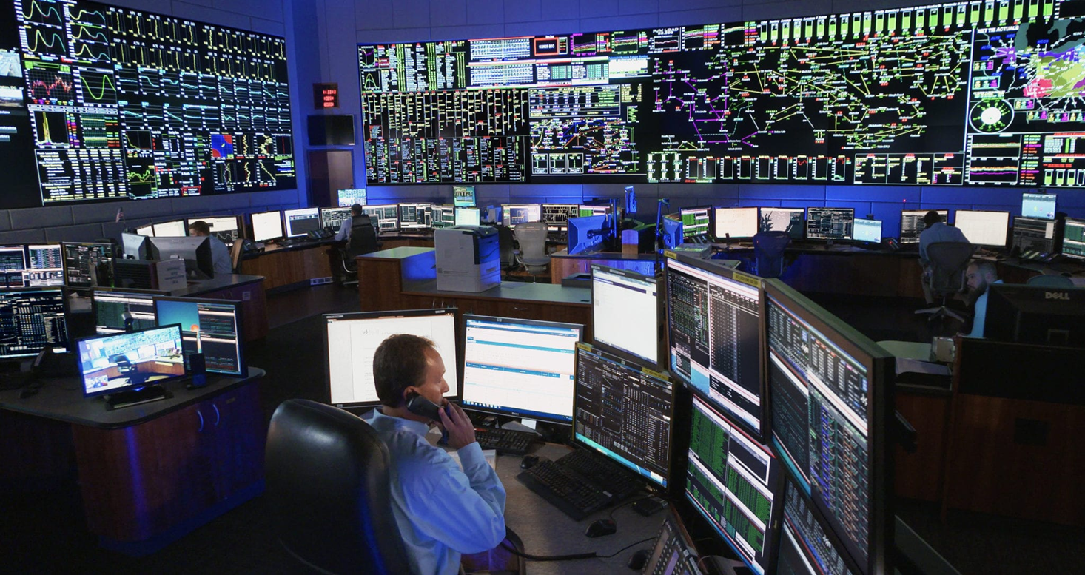
What we have today is Region Transmission Organizations (RTO) or Independent System Operator (ISO)
Connector
Credit: https://www.rtoinsider.com/70686-five-pjm-states-bills-requiring-utilities-file-stakeholder-votes/
What we want to get to a State Distribution System Operator – Independent?

Slide 7
What we need to get to a VPP was a Smart Grid – Interoperability

Slide 8
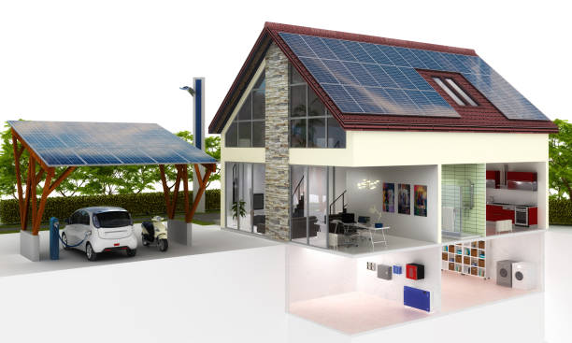
The future for clean energy – integrated and holistic – a system
You can: upgrade you home in term of the building shell and weatherization electrify your home with heat pumps, induction stoves and LED lights upgrade your ride to an EV and EV charger power your home and EV with solar and battery storage and mange your home with smart appliance and chargers
And you can send your stored energy to the grid as part of a virtual power plant
What would it take? Energy deregulation 2.0
Notes:
Residential customers have realized clear benefits as well…..

Slide 9
Benefits of VPP
Adding capacity and quickly GW nation wide (without big siting/permitting issues)
Economic Efficiency – the market delivers the value (but with rules)
Energy Efficiency - better use of all the components in the system
Better understanding of the energy system – education
Cleaner with the same or better reliability, resiliency and affordability
THERE ARE COSTS

